Slide 2
Unit 4: Arrays and Strings (6hrs)
Introduction to arrays
One-dimensional and Multidimensional arrays
Initialization of arrays and accessing the elements of arrays
Strings- the character arrays
Functions related to the strings

Slide 3
Recap
Recap:
Data Types
Variables
For loop, While loop, Do-while loop
If-else, If-else if-else, If-else if-else if-else, Switch statements.
WAP to enter two integers and display their sum.
WAP to enter one hundred integers and display their sum.
Do you have any difficulties solving this problem?

Slide 4
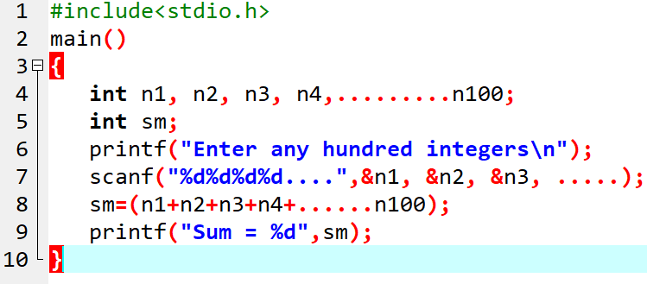
4.1 Introduction to Arrays
Your basic solution could be:

Slide 5
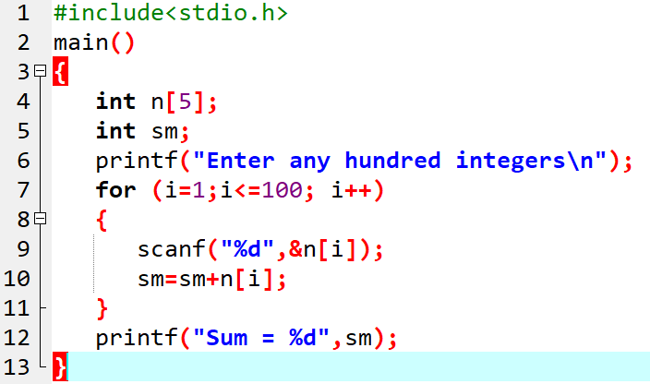
4.1 Introduction to Arrays
Here, n[5] is an array.
It holds the last 5 integer data only.
Will this be better?

Slide 6
4.1 Introduction to Arrays
An array is a group of similar datatypes with a common name.
This means that an array can store all integers, floating point numbers, or characters.
The individual data items stored in an array are called its elements.
Eg: int n[5]
This n is an array that can store five integer values.

Slide 7
4.1 Introduction to Arrays
Creation of an Array
To create an array, define the data type (like int) and specify the name of the array followed by square brackets [].
To insert values to it, use a comma-separated list inside curly braces, and make sure all values are of the same data type:
int myNumbers[] = {25, 50, 75, 100};
We have created a variable with an array of four integers.

Slide 8
4.1 Introduction to Arrays
Access the Elements of an Array
To access an array element, refer to its index number.
Array indexes start with 0:
[0] is the first element, [1] is the second element, etc.
This statement accesses the value of the first element [0] in myNumbers:
int myNumbers[] = {25, 50, 75, 100};
printf("%d", myNumbers[0]);
// Outputs 25

Slide 9
4.1 Introduction to Arrays
Change an Array Element
To change the value of a specific element, refer to the index number:
int myNumbers[] = {25, 50, 75, 100};
myNumbers[0] = 33;
printf("%d", myNumbers[0]);
// Now outputs 33 instead of 25

Slide 10
4.1 Introduction to Arrays
Set Array Size
Another common way to create arrays, is to specify the size of the array, and add elements later:
// Declare an array of four integers:
int myNumbers[4];
// Add elements
myNumbers[0] = 25;
myNumbers[1] = 50;
myNumbers[2] = 75;
myNumbers[3] = 100;

Slide 11
4.1 Introduction to Arrays
Avoid Mixing Data Types
It is important to note that all elements in an array must be of the same data type.
This means you cannot mix different types of values, like integers and floating point numbers, in the same array:
// Declare an array of four integers:
int myArray[] = {25, 50, 75, 3.15, 5.99, ‘Mark’};

Slide 12
4.2 Types of Arrays
Two types:
Single Dimensional Array
Multidimensional Array
2-D
3-D
And so on.

Slide 13
i) Single Dimensional (1D) array
Used to store a list of items that are of similar type.
General Syntax:
Dataype arrayname[size];
Eg: int num[5];
where, int specifies datatype of the variable,
num specifies array name,
size specifies the maximum no. of elements
num[0] | num[1] | num[2] | num[3] | num[4]

Slide 14
Initialization of 1-D array
Compile-time Initialization
Eg:
int num[3]= {10, 20, 30];
int num[ ]= {10, 20, 30};
Or
int num[3];
num[0]=10;
num[1]=20;
num[2]=30;
Run-time Initialization
Eg:
for ( i=0 ; i<10 ; i++)
{
scanf(“%d”, &num[i]);
}

Slide 15
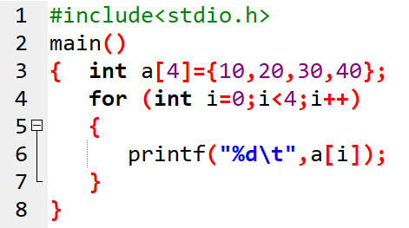

Prog. 1: WAP to initialize a set of certain numbers to demonstrate compile time initialization of 1-D array. Also display those numbers.

Slide 16
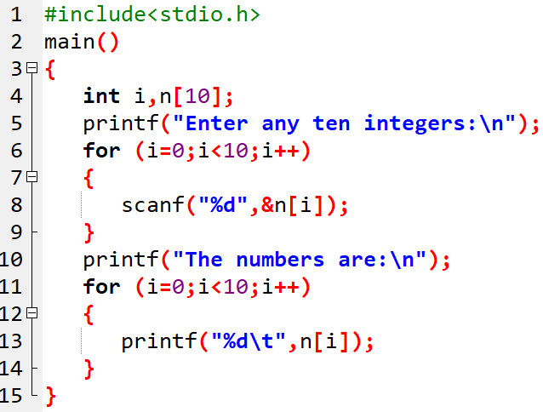

Prog. 2: WAP to read 10 numbers from the user and display them using array.

Slide 17
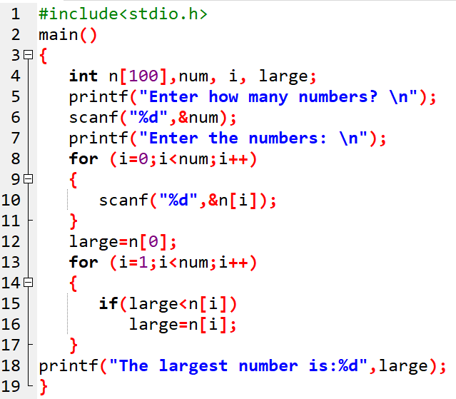
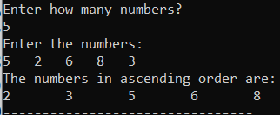
Prog. 3: WAP to input n numbers and find the largest among them.

Slide 18
ii) Multidimensional array
Multidimensional arrays are those which have more than one dimension.
It can be 2-D, 3-D and so on.
They are defined in the same manner as 1-D array except that a separate pair of square bracket is required for each dimension.
The general form is:
Datatype arrayName [size1] [size2]…[sizeN];

Slide 19
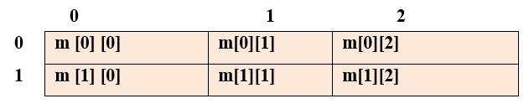
2-D array
The simplest form of multidimensional array is the 2-D array.
2-D array has two subscript.
Eg: int n[2][3]
Here 2 represents two rows and 3 represents three column

Slide 20
Initialization of 2-D array
Compile-time Initialization
Eg:
int num [3][3] = { {1,2,3} , {4,5,6} , {7,8,9} };
int num [ ][3] = { {1,2,3} , {4,5,6} , {7,8,9} };
or
int num[3][3];
num[0][0]=1;
num[0][1]=2;
num[0][2]=3;
………………….
num[3][3]=9;
b) Run-time Initialization
Eg:
for (i=0;i<2;i++)
{
for(j=0;j<2;j++)
{
scanf("%d",&m[i][j]);
}
}

Slide 21
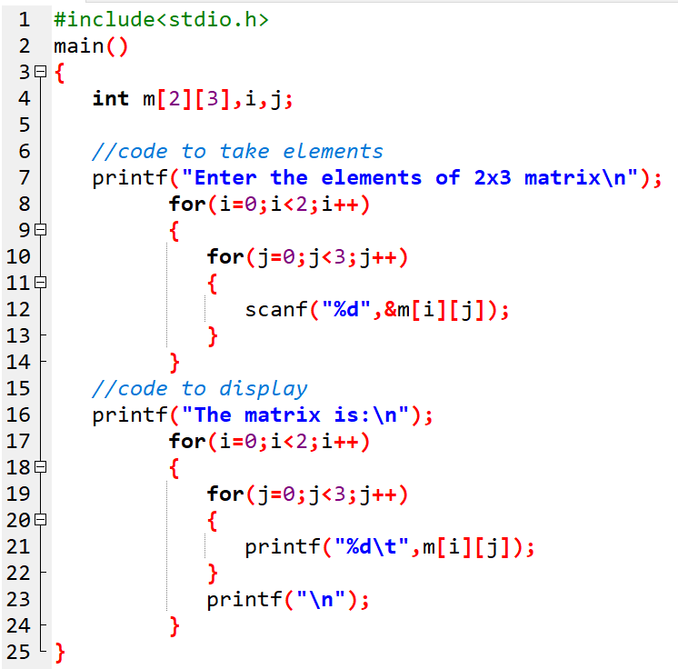
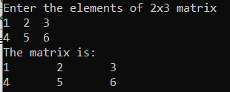
Prog. 4: WAP to read a matrix of size 2x3 from the user and display them on the screen.

Slide 22
Assignment 1:
WAP to read values of 3 × 3 order matrix, then compute the sum of even elements.
WAP to find the sum of all elements of a 3 × 3 matrix.
WAP using array to enter n numbers and display the sum of those numbers which are greater than 10.

Slide 23
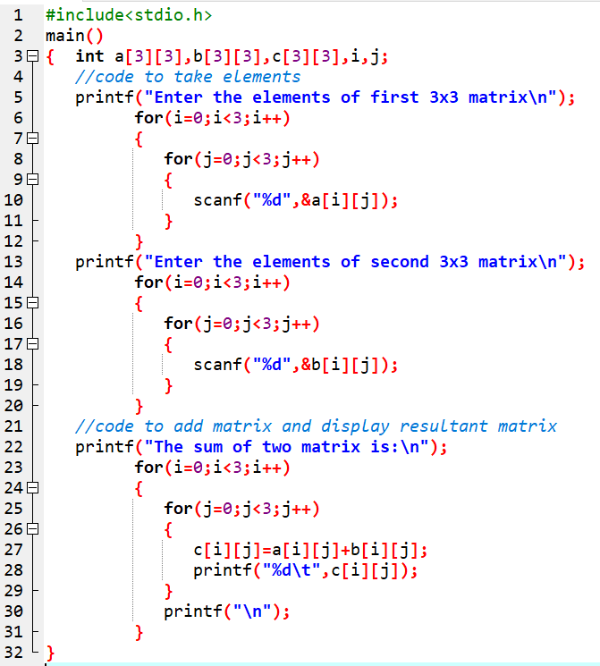
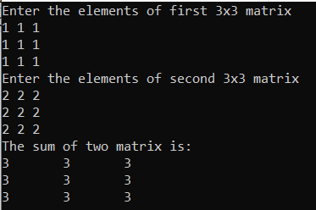
Prog. 5: WAP to read the elements of given two matrix of order 3x3 from the user and perform matrix addition.

Slide 24
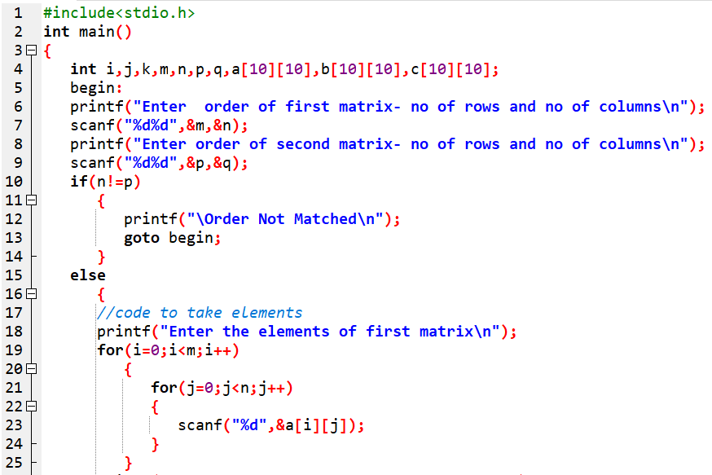
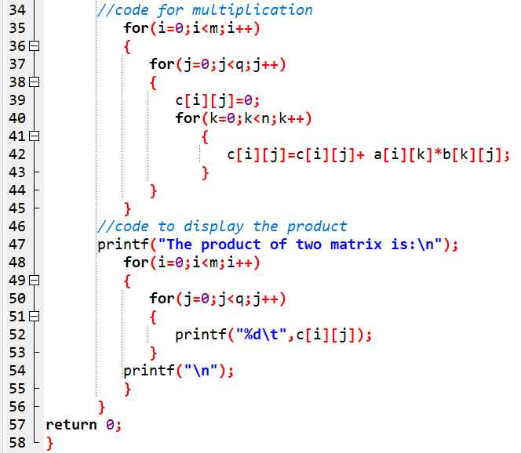
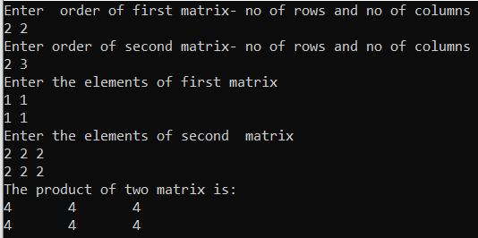
Prog. 6: WAP to enter two matrix of mxn size and perform matrix multiplication, and display the result.

Slide 25
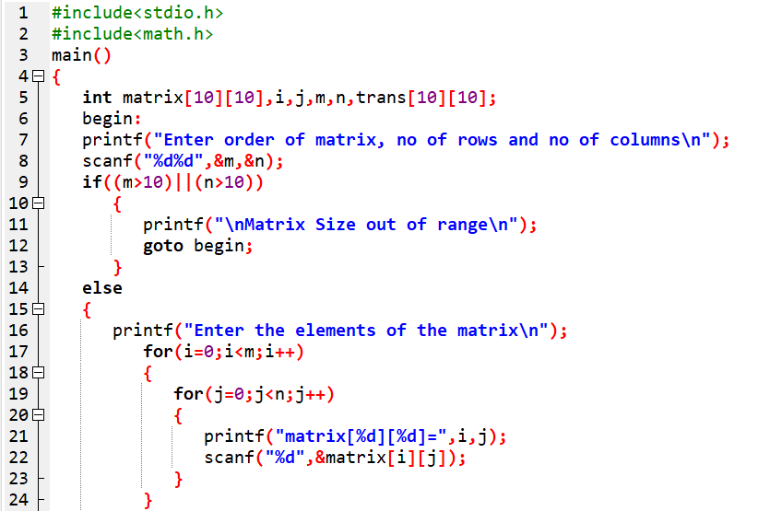
Prog. 7: WAP to read order of a matrix and its elements. Find the transpose matrix of the input matrix.

Slide 26
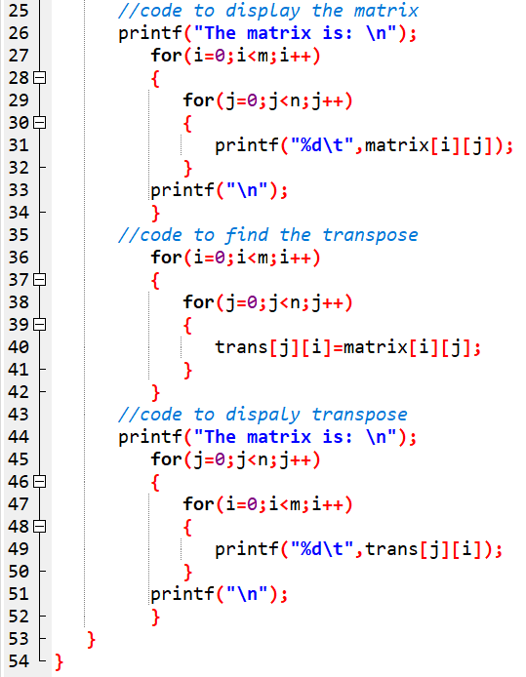
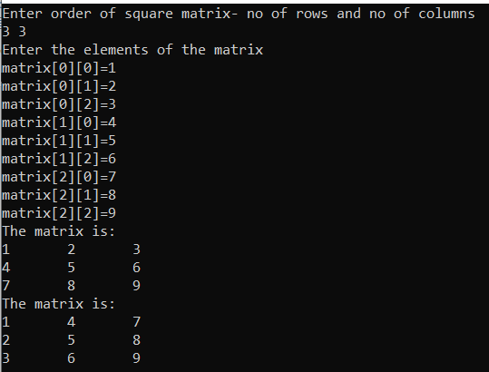

Slide 27
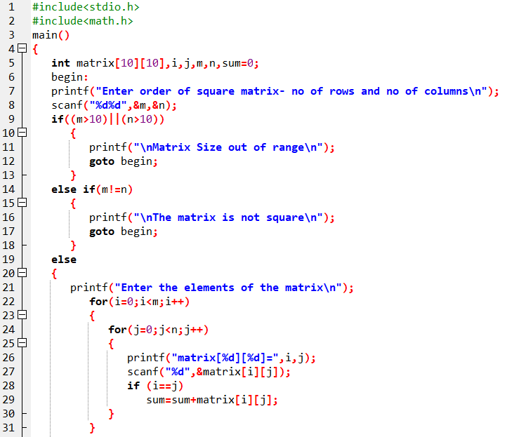
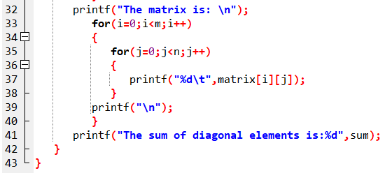
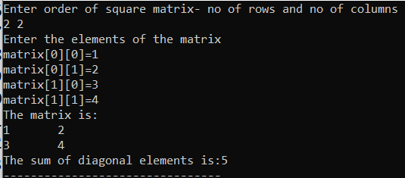
Prog. 8: WAP to read a square matrix and its elements and find the sum of diagonal elements (i.e. trace of matrix).

Slide 28
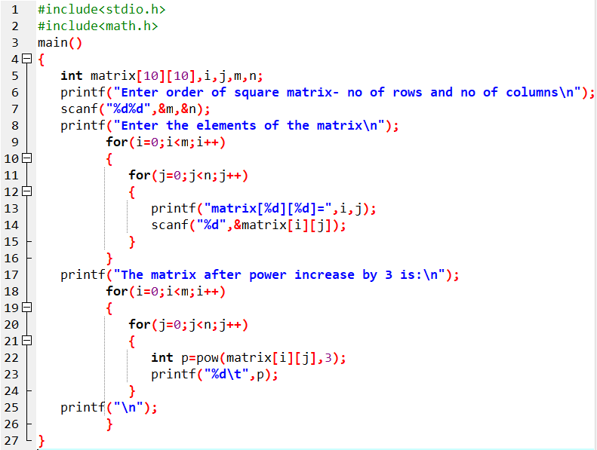
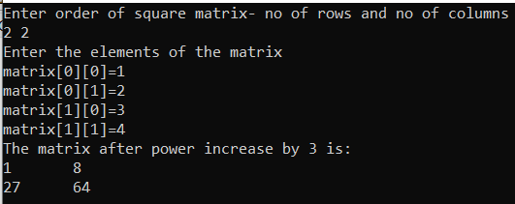
Prog. 9: WAP to enter a mxn matrix and display the matrix by increasing all the elements by power of 3.

Slide 29
Assignment 2:
WAP to read a square matrix and display the upper triangular matrix.
WAP to read a square matrix and display the lower triangular matrix.
WAP to read a matrix and display the individual sum of each row of the matrix.

Slide 30
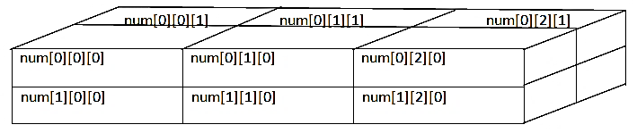
3-D Array
has three subscripts.
The general syntax :
Datatype ArrayName [sub1][sub2][sub3];
Eg:
int num[2][3][2];

Slide 31
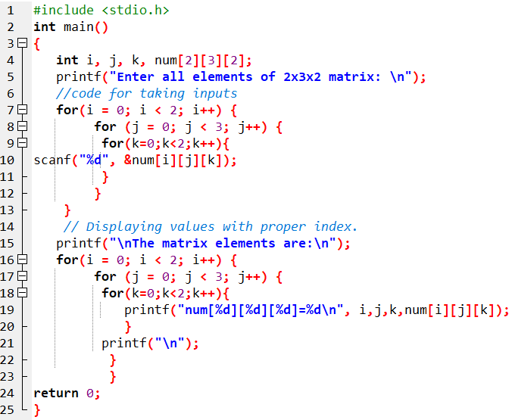
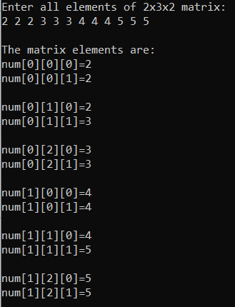
Prog. 10: WAP to create a 3-D array of size 2x3x2 to accept elements from user, and finally display them.

Slide 32
End of Lecture 9

Slide 33
Strings

